Slide 1
Intro

Slide 2
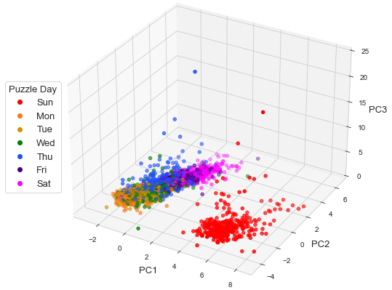
Notes:
Fig. 1

Slide 3
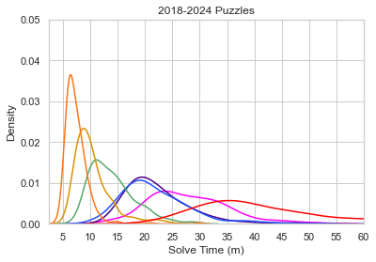
Notes:
Fig. 2

Slide 4
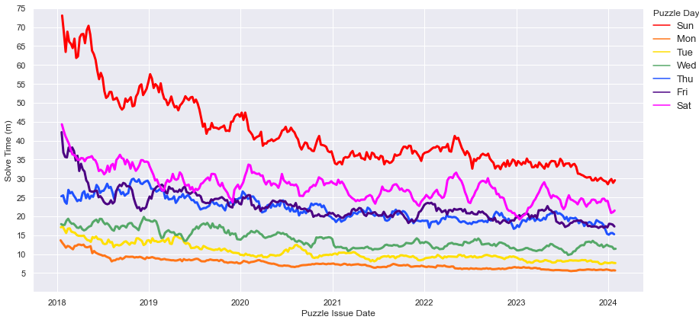
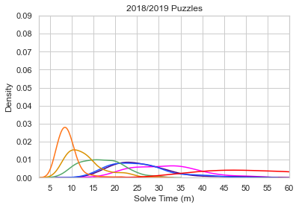
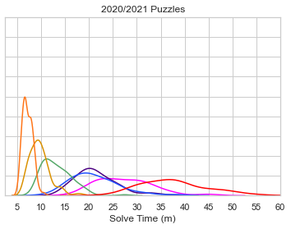
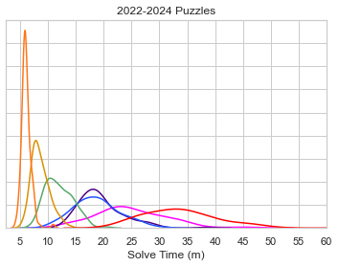
Notes:
Fig. 3

Slide 5
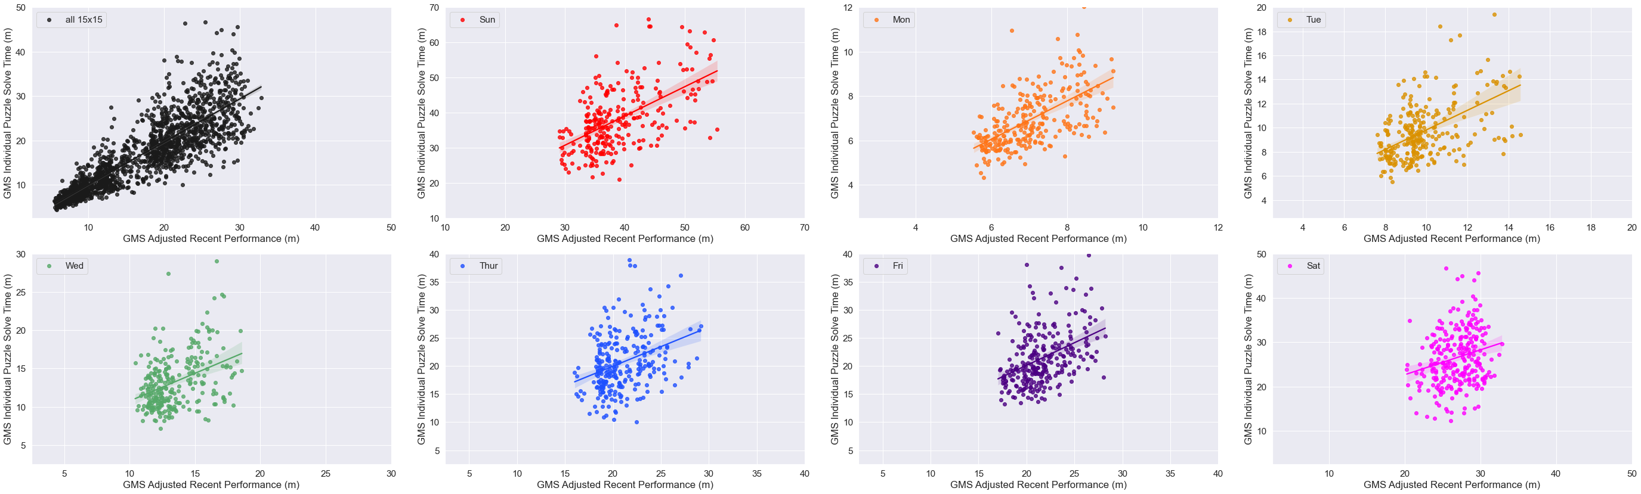
Notes:
Fig. 4

Slide 6
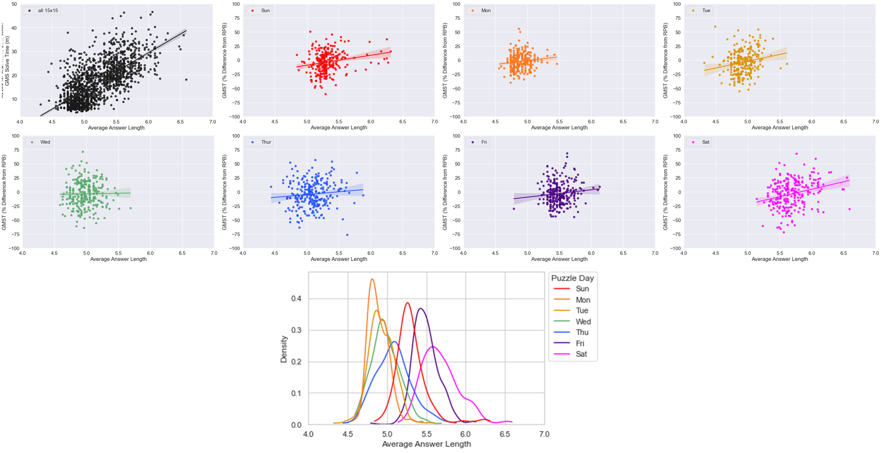
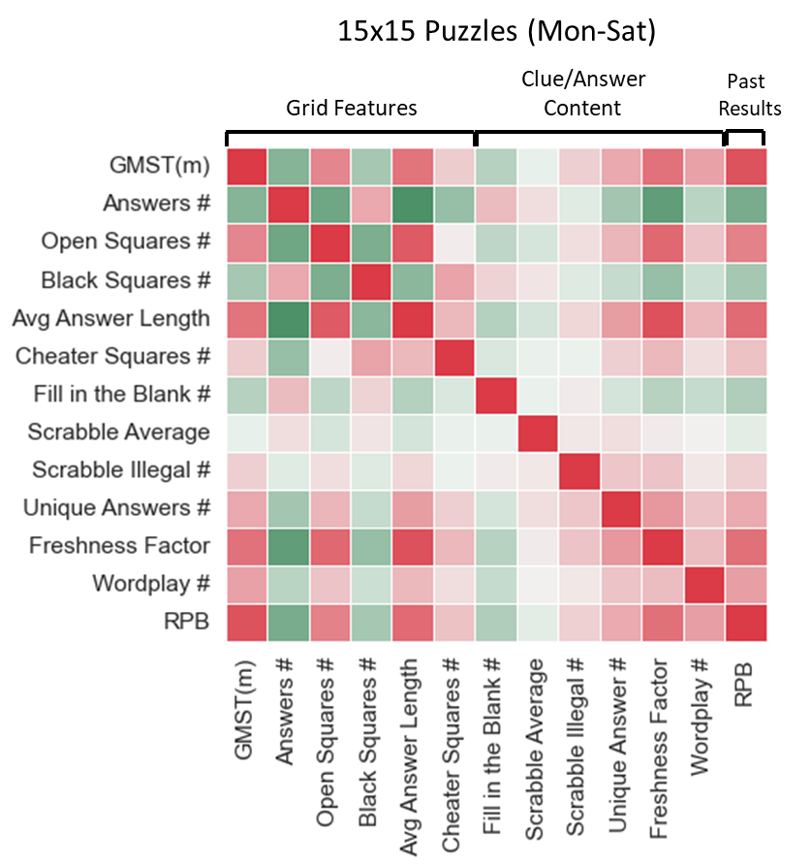
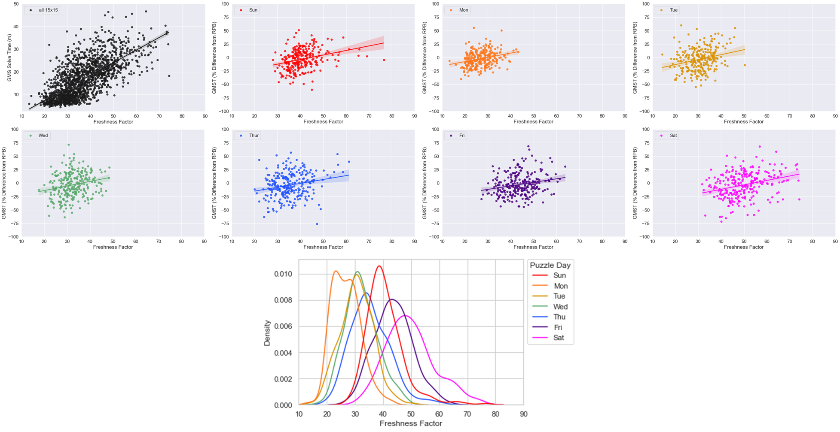
Notes:
Figure 5

Slide 7
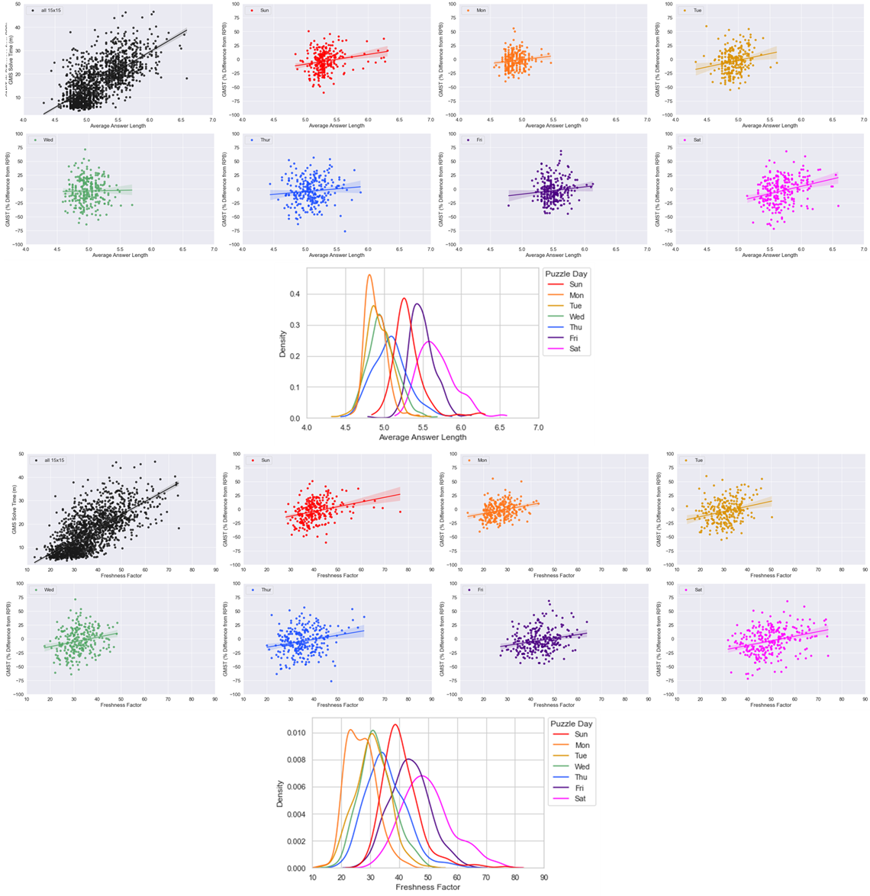
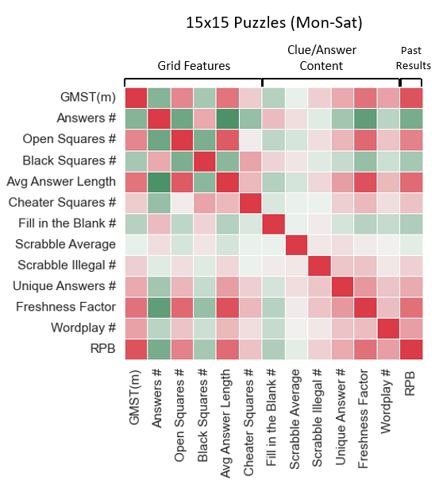
Notes:
Fig. 5

Slide 8
Methods

Slide 9
Solver Past Performance Features (n=6)
‘Strength of Schedule’-Adjusted
(n=2/6)
PREDICTED 15x15 PUZZLE
(TARGET FEATURE: IS1 RAW SOLVE TIME)
Circadian
Features
(n=1)
0
Puzzle: Clue or Answer Features
(n=19)
Recent Past Performance Features Adjusted by ‘Strength of Schedule’ (SOS) Ratio:
GMS Performance on These Puzzles/GMS Recent Performance Prior to These Puzzles
IS1
Recent Past
Performance
Features
Accrued
Puzzle Day of Week
(n=1)
# Day-Specific Puzzle Prior to Predicted Puzzle
No Time-Decay
Weighting in
Final Model
Puzzle: Grid Features
(n=11)
-8
Notes:
Fig. 2

Slide 11
Results

Slide 12
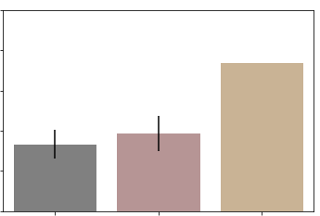
7
6
5
Training Error in minutes (RMSE)
4
3
2
Best Model
Mean PDS IST
Dummy
Benchmark Models
Notes:
Fig. 7

Slide 13
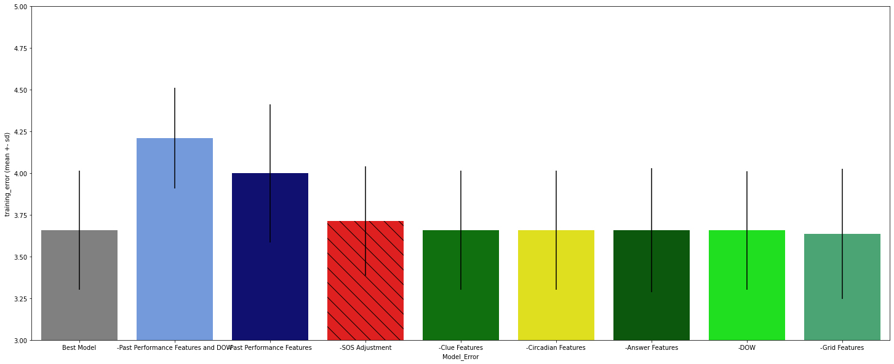
5.0
4.75
4.50
4.25
Training Error in minutes (RMSE)
4.0
3.75
3.50
3.25
3.0
Full Best Model
Past Performance
AND DOW
Past Performance
SOS Adjustment
Clue
Circadian
Answer
DOW
Grid
Subtracted Feature Class or Adjustment Type
Notes:
Fig. 8

Slide 14
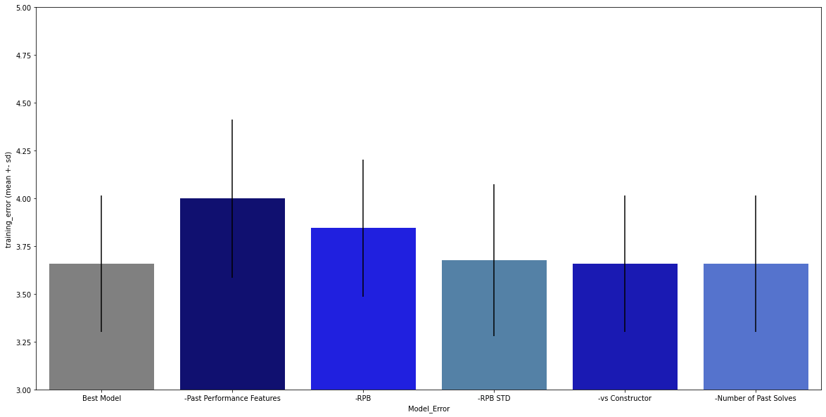
5.0
4.75
4.50
4.25
Training Error in minutes (RMSE)
4.0
3.75
3.50
3.25
3.0
Full Best Model
All Past Performance Features
Recent Performance Baseline
Std of Recent Performance Baseline
Past Performance vs Constructor(s)
# Past Solves
(Day Specific or Non-DS)
Subtracted Past Performance Feature(s)

Slide 15
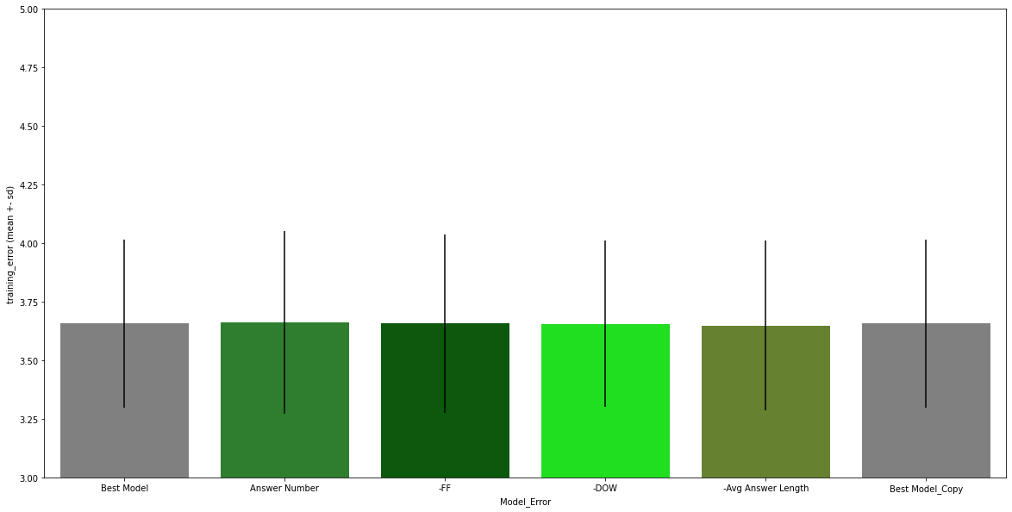
Full Best Model
Answer #
(Grid)
Freshness Factor
(Answer)
Puzzle Day of Week
Avg Answer Length
(Grid)
Subtracted Other Class Feature(s)

Slide 16
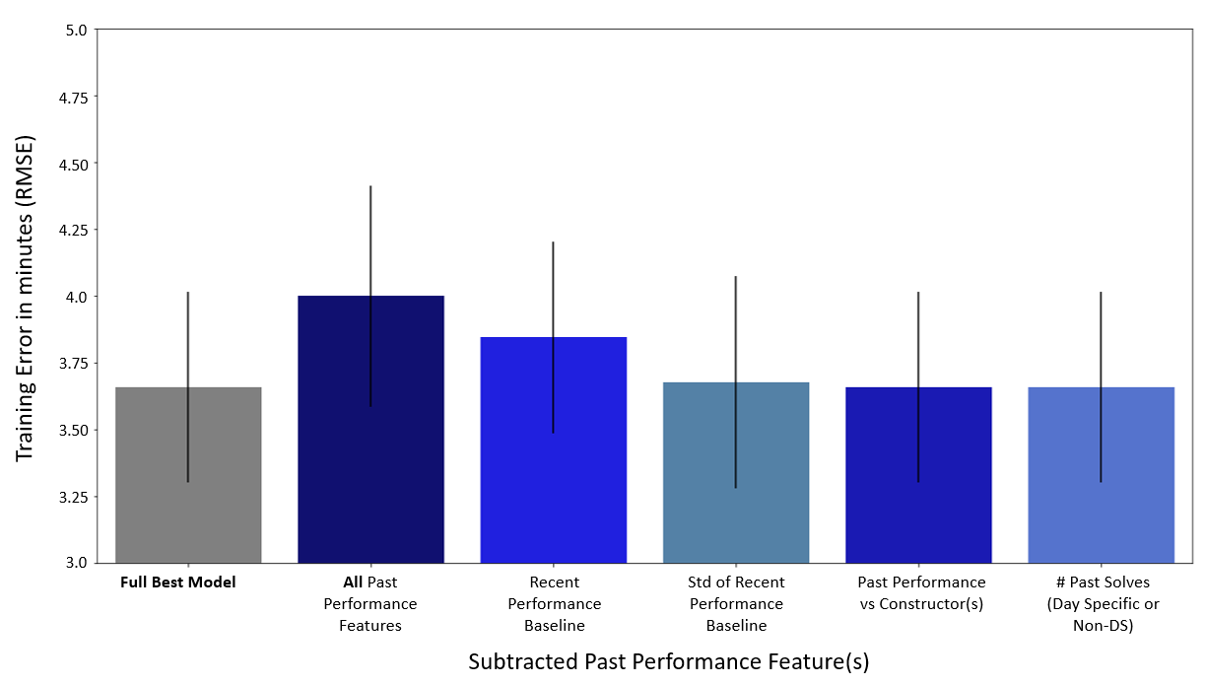
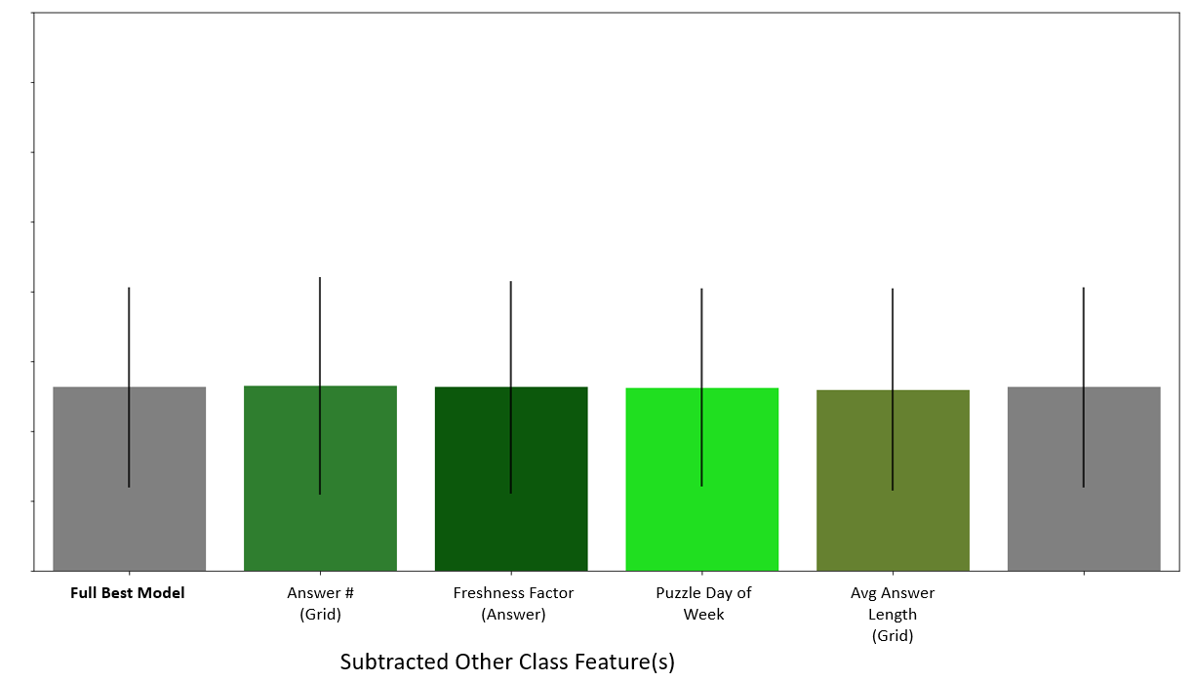
Notes:
Fig. 9

Slide 17
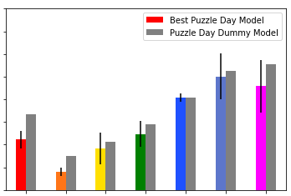
50
45
40
35
Training Error as % of mean solve time (RMSE)
30
25
20
15
10
Sun
Mon
Tue
Wed
Thu
Fri
Sat
Puzzle Day
Notes:
Fig. 10

Slide 18
Data Supplement

Slide 19
Puzzle Feature Name | Feature Class | Source(s) | Descriptions/Notes
IS1_ST(m) | Target | XWStats | Individual Solver 1 (IS1) raw solve time, in minutes, for a given 15x15 puzzle
IS_RPB_l8 | Past Performance | XWStats/Me | Strength of Schedule-adjusted mean of previous (to a given solve) 10 puzzles, for the relevant 15x15 puzzle day
IS_RPB_l8_stdev | Past Performance | XWStats/Me | Standard deviation of Strength of Schedule-adjusted version of IS_RPB_l8 (recent solve variability)
IS Past Perf vs Constr | Past Performance | XWStats/Me | Past performance vs a specific constructor or specific constructor team; normalized to account for recent (past 8 puzzles) performance baseline per puzzle day (RPB) and past puzzle day mix for constructor(s)
Prior Solves # - DS | Past Performance | XWStats/Me | Number of solves on a given 15x15 puzzle day prior to a solve to be predicted; experience proxy
Prior Solves # - NDS | Past Performance | XWStats/Me | Number of solves across all 15x15 puzzle days prior to a solve to be predicted; experience proxy
IS Solves l7 | Past Performance | XWStats/Me | Number of total solves in the past 7 days prior to a given puzzle solve
DOW_num | Puzzle Day | Me | Assigns number to a given solve for the 15x 15 puzzle day of week (Mon-Sat)
Answer # | Grid | XWord Info | XWord Info calls answers “words”
Average Answer Length | Grid | XWord Info | XWord Info calls answers “words”
Blocks # | Grid | XWord Info | Blocks = black squares
Cheater Square # | Grid | XWord Info | Blocks than can be removed without affecting the overall word count of the grid
Circle # | Grid | XWord Info | Mostly seen in early week and Sunday puzzles
Open Squares # | Grid | XWord Info | Counts all white squares that are non-adjacent to black squares
Shade # | Grid | XWord Info | Counts all shaded squares in the grid; mostly seen in early week and Sunday puzzles
Spans # | Grid | XWord Info | Counts # of row or columns with 0 black squares (15 or 21 answer length, depending on grid size)
Stacks # | Grid | XWord Info | Counts # of times two or more adjacent rows or columns have all white squares (mostly Fri or Sat)
Unchecked Squares # | Grid | XWord Info | Squares that are part of only either the Across or Down clue, but not both
Unusual Symmetry | Grid | XWord Info | Assigns ‘1’ to all puzzles displaying other than normal rotational symmetry (e.g., L-R Mirror or Diagonal)
Cross Reference Clues # | Clue | XWord Info | Clue that refers to another clue (ex. “See 48-Down”)
Duplicate Clues # | Clue | XWord Info | When the same clue is used verbatim for more than one answer (uncommon)
Uniclue | Clue | XWord Info | When the same clue is used for both an Across and a Down entry (very rare)
Wordplay # | Clue | Manual (me) | Subjective count of clues displaying wordplay/punnery; many end with a ‘?’, ‘perhaps’, or ‘maybe’
Black Square Fill # | Answer | XWord Info | Number of black squares in the grid that contain at least one character (very rare)
Day Freshness %ile | Answer | XWord Info | Assigns percentile across all puzzles for the puzzle day of a given puzzle for Freshness Factor
Duplicate Answers # | Answer | XWord Info | When the same answer is used verbatim for more than one clue (rare)
Fill-in-the-Blank # | Answer | XWord Info | Number of fill-in-the-blank answers in a given puzzle
Freshness Factor | Answer | XWord Info | Assigns an overall rarity score to a puzzle’s answers, using both pre-Shortz and Shortz puzzles
Outside Grid # | Answer | XWord Info | Number of “virtual” squares outside the grid that contain at least one character (very rare)
Overall Freshness %ile | Answer | XWord Info | Assigns percentile across all puzzles from all puzzle days for Freshness Factor
Quantum | Answer | XWord Info | 1 denotes more than 1 valid answer for a clue (very rare)
Rebus # | Answer | XWord Info | Counts number of squares where more than one letter, number or symbol is required for a solve
Rebus Unique # | Answer | XWord Info | Same as above, but only counts squares with unique rebus content in the given puzzle
Scrabble Average | Answer | XWord Info | Treats each white square like a (non-blank) Scrabble tile and assigns per-square average point value
Scrabble Illegal # | Answer | XWord Info | Counts all answers that would not be playable based on the Official Scrabble Dictionary
Scrabble Score | Answer | XWord Info | Treats each white square like a (non-blank) Scrabble tile and assigns total point value for the puzzle
Unique Answer # | Answer | XWord Info | Counts all answers not occurring in any other pre-Shortz or Shortz Era puzzle
Unused Letters # | Answer | XWord Info | Counts the number (out of 26) of letters not used in a puzzle (0= pangram)
Completion Hour | Circadian | XWStats/Me | Hour of completion for a given puzzle
IS_per_sdp_avg_past_diff_from_RPB | Circadian | XWStats/Me | For a given puzzle, percent difference in solve time from recent performance baseline (RPB) for that specific solve day phase
Solve Day Phase | Circadian | XWStats/Me | Portion of 24 hour cycle a puzzle was solved in (1 = 12-6 AM; 2 = 6 AM-12 PM; 3 = 12 PM-6 PM; 4 = 6 PM-12 AM)
Notes:
Supp. Table 1

Slide 20
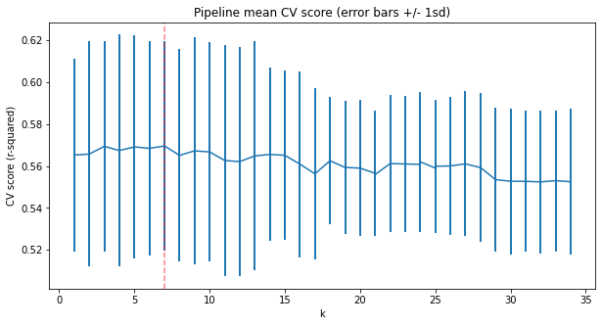
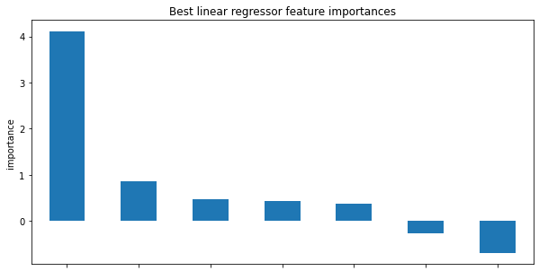
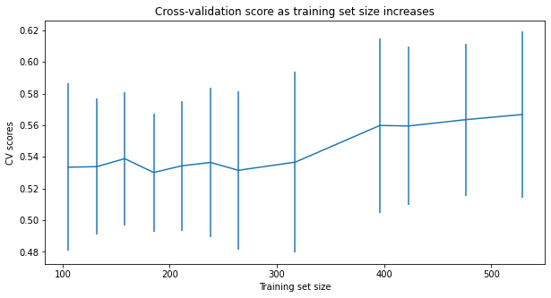
A
B
RPB_l8
Answer #
DOW_num
C
Freshness Factor
RPB_l8_stdev
Average Answer Length
Overall Freshness %ile
Notes:
Supplementary Fig. 1

